Slide 1


D. K. T. E. SOCIETY’S TEXTILE & ENGINEERING INSTITUTE,
ICHALKARANJI.
Project Mentor
S. D. Rane sir
TEAM Members
Rutuja Chougule
Prajakta Darekar
Pooja Hanamane
Arya Jagdale

Slide 2

GreenTrust Rentals
Problem Statement
Agri-Equipments Rental System for Farmer

Slide 3
Problem Description
GreenTrust Rentals
"Our project aims to provide individuals and businesses with easy access to high-quality farming equipment on a rental basis, offering a cost-effective and convenient solution for their farming needs. Through a user-friendly platform, we will offer a diverse range of well-maintained equipment, ensuring customer satisfaction and successful project completion."

Slide 4


GreenTrust WORKFLOW
2.ADDING EQUIPMENT
The owner can add
equipment along with the description, details.
3. BROW SE & ADD TO wishlist Creates a profile, browses, filters and displays equipments.
1. FARM ER ON B OARDS
Farmer creates a profile using email id and Mobile number and password
4. CONTACT US
Customers can ask queries or chat with the owners for booking discussions and other issues.
6. ACCEPT REQUESTS
Owner accepts the request for the booking.
5.PRODUCT AVALIABILITY
based on user's current location.

Slide 5

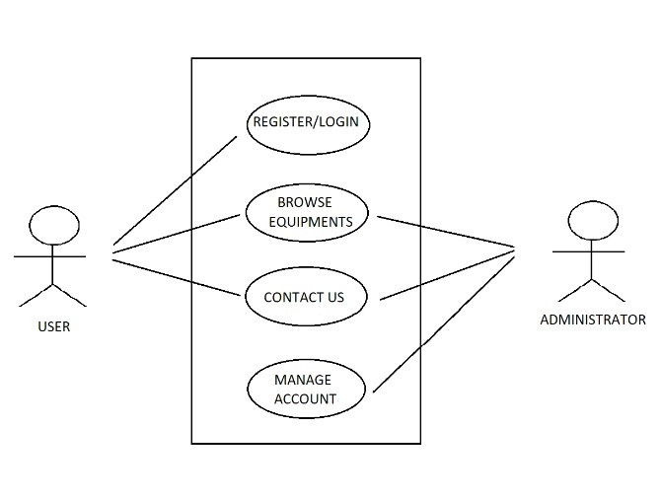
Use Case Diagram

Slide 6
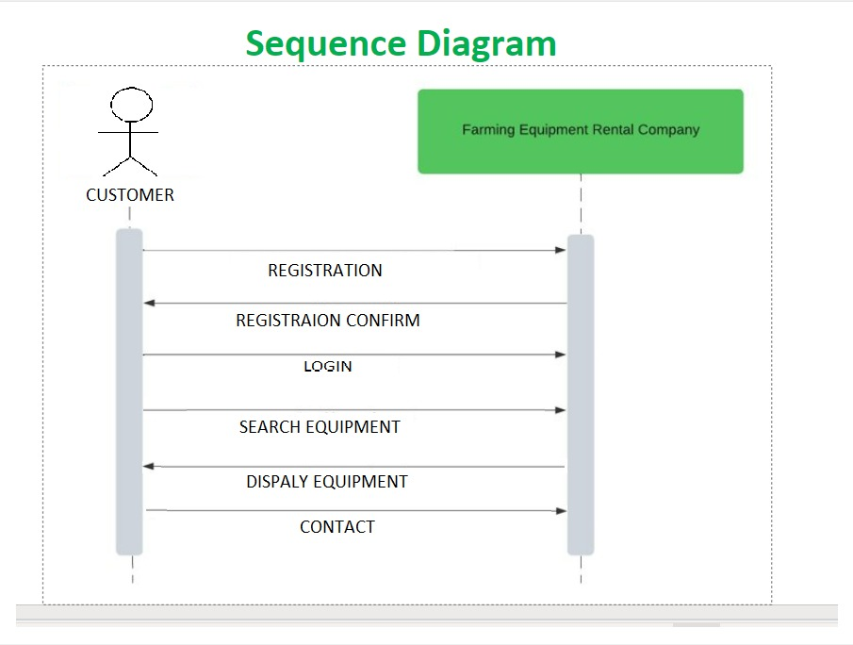

Slide 7
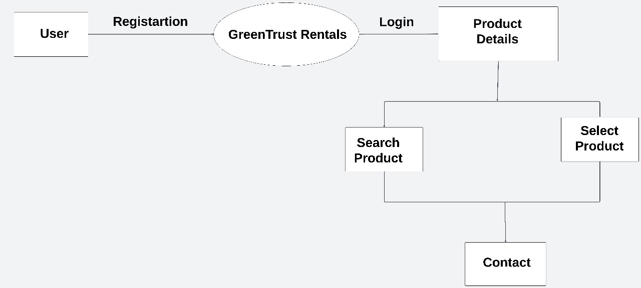
System Architecture

Slide 8
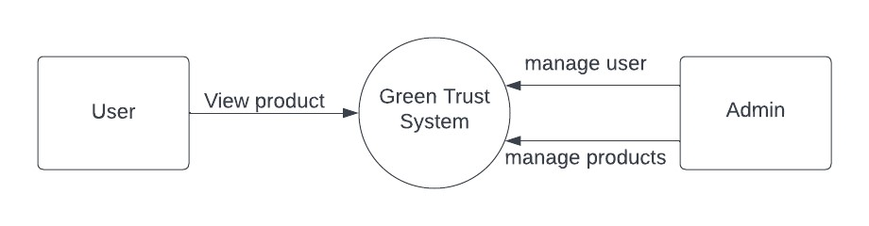
Data Flow Diagram
Level 0

Slide 9
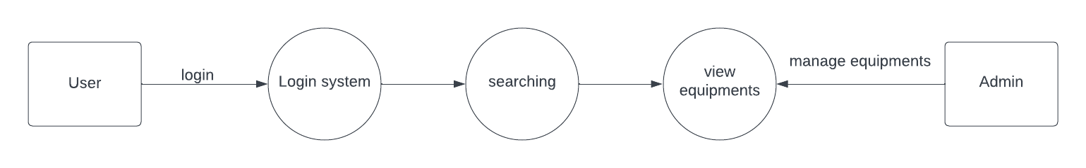
Data Flow Diagram
Level 1

Slide 10
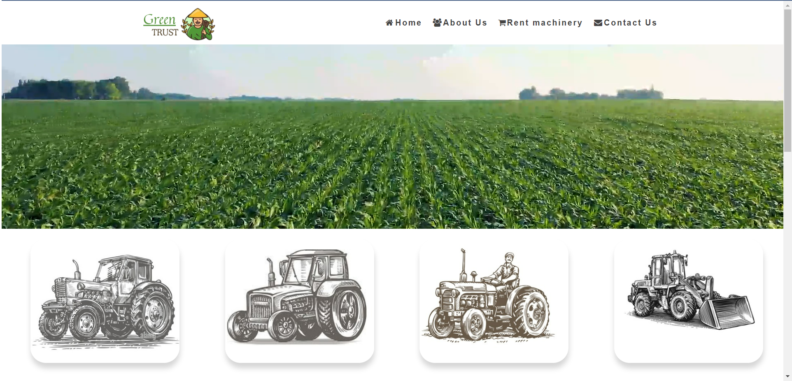


FEATURES
Customer profile
User-Friendly
Interface
Dashboard for
Equipment
Customer Support
Search and Filter Equipments

Slide 11
Why Farmers need Equipment on Rent
Cost savings -Renting equipment is a cost-effective option for farmers, as it allows them to avoid the high upfront costs of purchasing machinery.
Access to specialized equipment: -Renting equipment is a cost-effective option for farmers, as it allows them to avoid the high upfront costs of purchasing machinery.
Reduced storage space - Owning and storing farm equipment can be challenging, especially for small farms. Renting eliminates the need for dedicated storage space, freeing up valuable land and resources.
Seasonal needs - Many farming activities are seasonal, and renting equipment enables farmers to acquire the specific tools they need for a particular season or task without the need for long-term ownership.

Slide 12

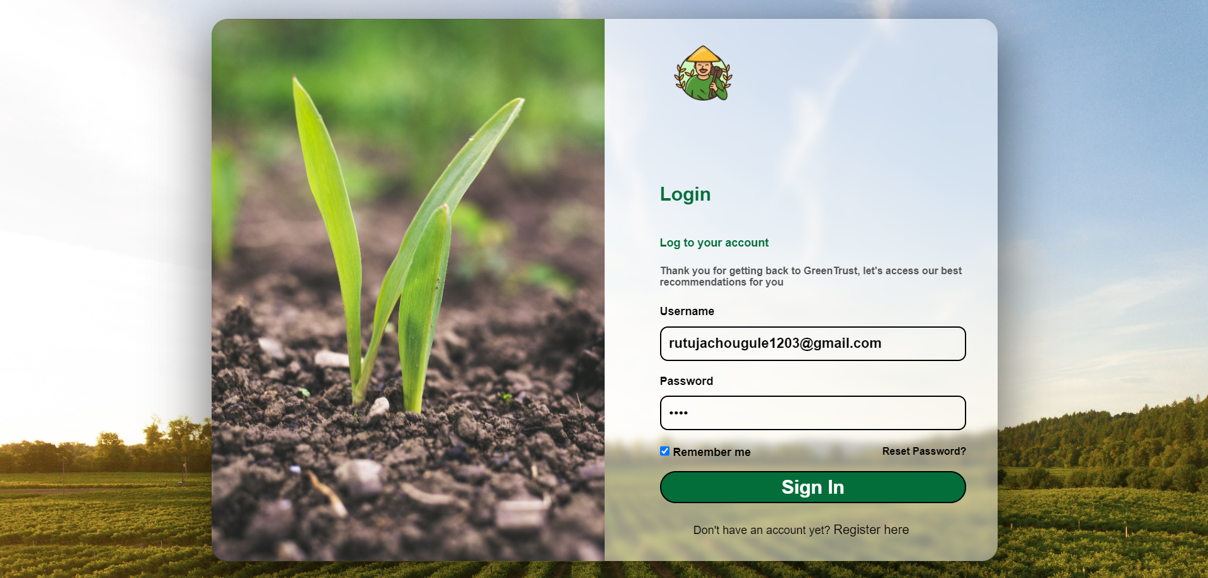
Dashboard Functionality
It consists of ADDING
PRODUCT, VIEW ING PRODUCTS etc.
The admin can write full description about equipment that includes equipment name , photo , description ,rent price and contact number.

Slide 13
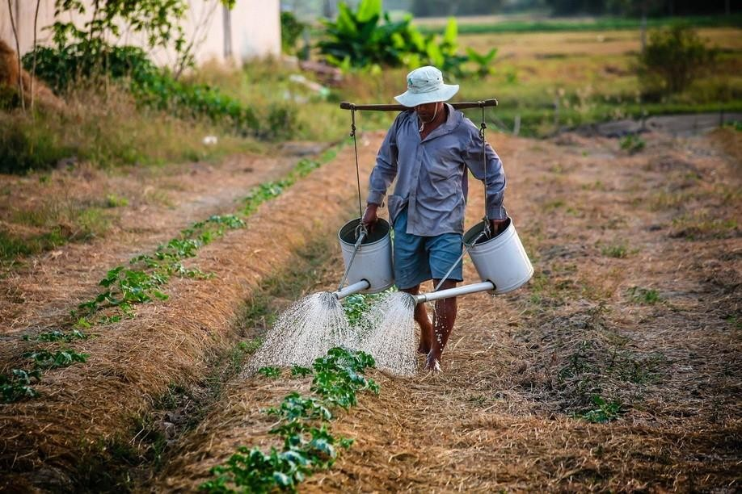
THANK YOU
"If the Farmer is Rich, then so is the Nation."

